Slide 1
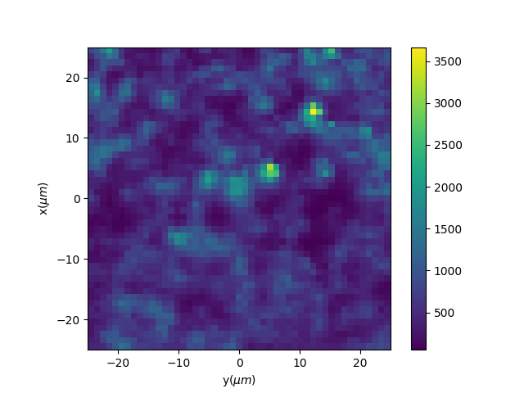
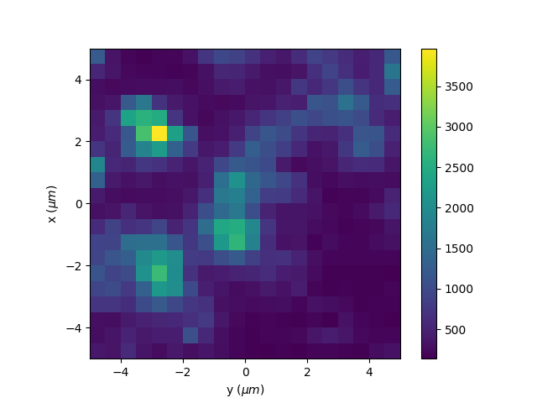
Scanning confocal image of Quantum Dots
Pixel size: 1x1 μm
Pixel size: 0.5x0.5 μm

